Slide 1






PYTHON BEGINNER COURSE
2024
2024
PYTHON
BEGINNER COURSE
Lesson 3
SHALEV LAU
/in/shalevl
/mushroomhater07

Slide 2
Iteration
while loop
for loop:
range()
Nested loops
Loop control statements:
break
continue
else

Slide 3
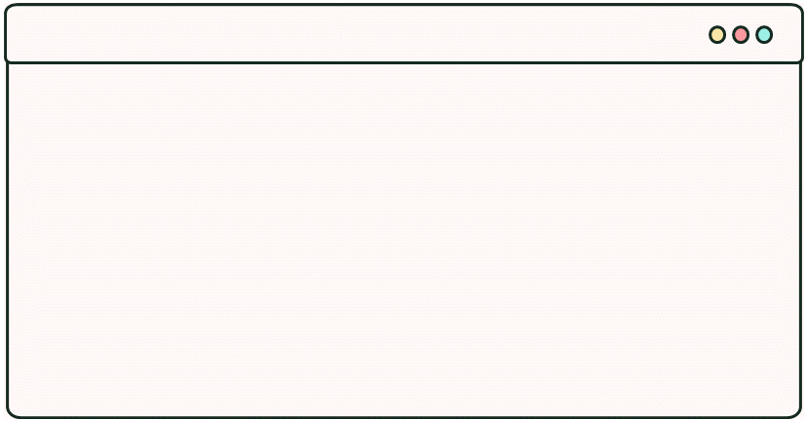
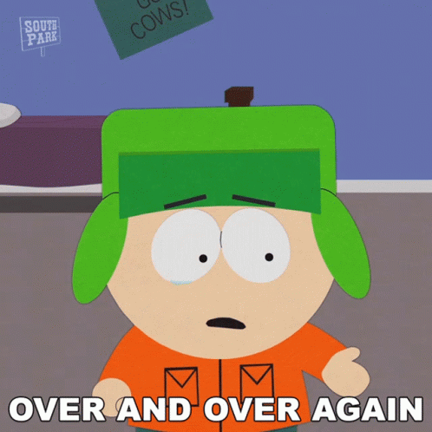
Loops
control statements that allow blocks of code to be repeated
If I want to print:
What I have to code
print(‘Hi’)
print(‘Hi’)
print(‘Hi’)
print(‘Hi)
print(‘Hi’)
print(‘Hi)
(...)
Hi
Hi
Hi
Hi
Hi
Hi
https://tenor.com/view/over-and-over-again-kyle-broflovski-south-park-s12e8-the-china-probrem-gif-21171264

Slide 4

Indefinite iteration: While Loop
Same as if condition:
Loops while the condition is true
Stops when the condition becomes false
Always check stopping condition before starting the loop
while count < 6:
print(“Hi”)
count += 1
https://tenor.com/view/too-many-counting-gif-15929632

Slide 5

While Loop :detailed
What: repeatedly execute block of code as long as the test expression (condition) is true.
When useful: We generally use this loop when we don't know the exact number of times to iterate.
count = 0
while count < 6:
print(“Hi”)
while count < 6:
print(“Hi”)
count += 1

Slide 6

While Loop :detailed
What: repeatedly execute block of code as long as the test expression (condition) is true.
When useful: We generally use this loop when we don't know the exact number of times to iterate.
count = 0
while count < 6:
print(“Hi”)
while count < 5:
print(count)
count += 1

Slide 7

Until Loop :example
# Calculate the sum of numbers until user enters 0
number = int(input('Enter a number: '))
total = 0
# iterate until the user enters 0
while number != 0:
total += number
number = int(input('Enter a number: '))
print('The sum is', total)
# Calculate the sum of numbers until user enters 0
number = int(input('Enter a number: '))
total = 0
# iterate until the user enters 0
until number == 0:
total += number
number = int(input('Enter a number: '))
print('The sum is', total)
Until
(NOT IN PYTHON)
Stop when condition is true

Slide 8
Endless (infinite) Loop
No stopping condition
Condition that never met +
causing the loop to start over
while true:
print("Iteration:", count)
#no stopping condition
while (count < 4):
count = 0 # loop start over
print("Iteration:", count)
count +=1

Slide 9
Do While (NOT IN PYTHON)
Run once before checking stopping condition
We want user to input a 4 digit passcode:
passcode = input("enter 4 digit passcode")
passcode = input("enter 4 digit passcode")
while len(passcode) < 4:
passcode = input("enter 4 digit passcode")
print("thank you")
do {
passcode = input("enter 4 digit passcode")}
while(len(passcode) < 4);

Slide 10
Structure Programming
Aim to write programs which are easy to understand and work efficiently.

Slide 11
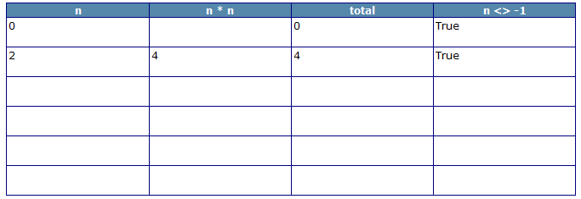
Dry-Run
Used to test an algorithm or program code without the use of a computer
Trace tables: a technique used to test algorithms to make sure that no logical errors occur
are used by programmers to track the values of variables as they change throughout the program (see what the code will do before executing it)
useful when a program is not producing the desired result (find where errors are in code)

Slide 12
To make a trace table
VARIABLES: note each variable in the piece of code you are looking at as a heading; (this includes arrays).
OUTPUTS: note if there is an output and put this as a heading
INPUTS: if there are inputs specified, put an inputs column and be prepared to fill it in.
Operations/manipulations to input, i.e. any conditions, formulae or comparisons

Slide 13
Make a Dry Run Table
x | y | y != 0 | Result
4 | 3 |  | 1
x ← 4 y ← 3
Result ← 1
While y != 0 Result ← Result * x y ← y – 1

Slide 14
Your Turn
i | j | i < j | k
i = 0
j = 10
WHILE i < j
i = i + 2
j = j – 2
k = j + i
END WHILE

Slide 15


Definite iteration: For loop
Known as fixed loop → number of iteration is predictable
Always has stepper variable → counting for every iteration started
9
“count 1 to 10” ➔
1, 2, 3, 4, 5,6,7,8,9,10
for item in range(10):
print(item)
https://giphy.com/gifs/harbornewebdesign-clicker-edcadmin-edc-admin-fVi8M1YPrfJgaqkJOA

Slide 16
For Loop :detailed
What: execute block of code set number of times.
When useful: We use this loop when we want to iterate over the sequence (range of numbers, string, list, etc.).

Slide 17
Definite iteration: For loop
for item in x:
print(item)
When x is a list e.g. x = ['apple', 'orange', 'banana']
When x is a string e.g. x = 'apple'
When x is range(end) e.g. x = range(4)
When x is range(start, end) e.g. x = range(2, 4)
When x is range(start, end, step) e.g. x = range(0, 10, 3)

Slide 18
Definite iteration: For loop
When x is a list e.g. x = ['apple', 'orange', 'banana']
for item in ['apple', 'orange', 'banana'] :
print(item)
The list length is known before running the loop
return each element in order

Slide 19
Definite iteration: For loop
When x is a string e.g. x = 'apple'
for item in 'apple' :
print(item)
When we iterate through "apple" (an example of string)
It will loop through each character
Result in a, p, p, l, e

Slide 20
Definite iteration: For loop
for item in range(4):
print(item)
When x is range(end) e.g. x = range(4)
Python count from 0, outputting 4 value
Resulting in 0,1,2,3

Slide 21
Definite iteration: For loop
for item in range(2, 4):
print(item)
When x is range(start, end) e.g. x = range(2, 4)
Count from 2, not outputting the end index
Resulting in 2,3

Slide 22



Definite iteration: For loop
When x is range(start, end, step) e.g. x = range(0, 10, 3)
Count from 0.
0, 1, 2, 3, 4, 5, 6, 7, 8, 9 ,10
0, 1, 2, 3, 1, 2, 3, 1, 2, 3, 1
1, 2, 3, 4, 5, 6, 7, 8, 9 ,10
for item in range(0, 10, 3):
print(item)
for item in range(1, 10, 3):
print(item)

Slide 23


Continue statement (while, for)
We use continue to skip the current iteration and immediately goes to the next iteration
i = 0
while i < 5:
if i == 3:
continue
print(i)
for i in range(5):
if i == 3:
continue
print(i)

Slide 24




+else (if)
Break statement
We use break to terminate the loop immediately
If break is used, it will pass to else statement before the rest of the code
for i in range(5):
if i == 3:
break
print(i)
print("loop completed")
i = 0
while i < 5:
if i == 3:
break
print(i)
else:
print("loop terminated by break")
print("loop completed")

Slide 25





Few point to mention
Must be 4 spacebar
(some IDE automatically turn TAB into 4 spaces but not gurantee)
score = int(input("input your score"))
while score < 60:
score += 10
else:
score -= 10
print(score)
Colon after condition OR else
Escape if with no indentation

Slide 26
In class exercise
Ask the user to enter 10 numbers. At the end, tell them the mean average, maximum and minimum of the values entered.

Slide 27
Project: Number guesser
Write a program that generates a random number between 1 and 100. Allow the user to keep guessing the number until they have guessed the random number.
Challenge: Extend/modify the above program to include the following
a) If they enter a number lower than the number generated, tell them that their number is too low. Do the same if they enter a number higher than the number generated.
b) tell them how many guesses they entered before each guess
c) set the (generated number +1) as landmine, if user entered that number, they lose.
import random
randomNumber = random.randrange(1, 50) + 1
# this code generate number from 1 to 50

